Slide 1
Text2Human: Text-Driven Controllable Human Image Generation
Author:
Yuming Jiang, Shuai Yang, Haonan Qiu, Wayne Wu, Chen Change Loy, Ziwei Liu
ACM Transactions on Graphics (TOG) - 2022
DOI: 10.1145/3528223.3530104
Long Pan

Slide 2
Motivation
Recent years have witnessed the rapid progress of image generation since the emergence of Generative Adversarial Networks (GANs) .
Human full-body images, another type of human-related media, are more diverse, richer, and fine-grained in content.
From the perspective of applications and interactions, apart from generating high-fidelity human images, it is even desirable to intuitively control the synthesized human images for layman users. For example, they may want to generate a person wearing a floral T-shirt and jeans without expert software knowledge.
Notes:
That's why these researchers wanted to study this topic. Then they implemented a system called text2human, which allows users to input only some descriptors, and then automatically generate a human image.

Slide 3
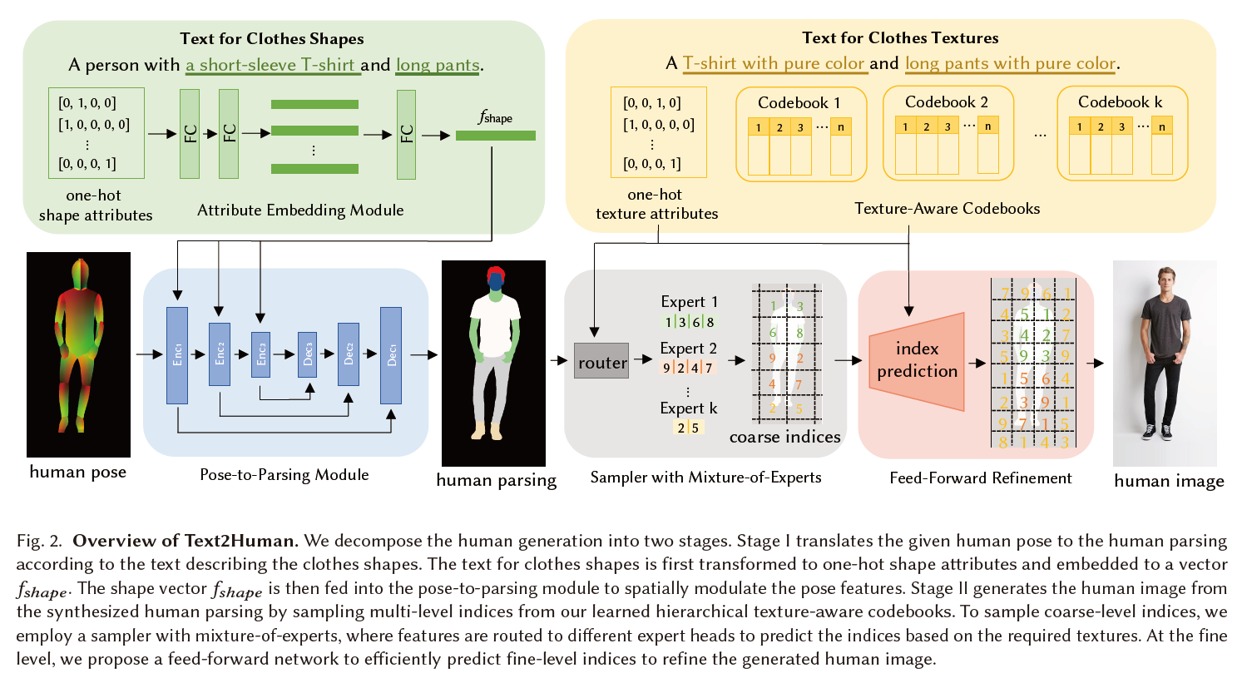

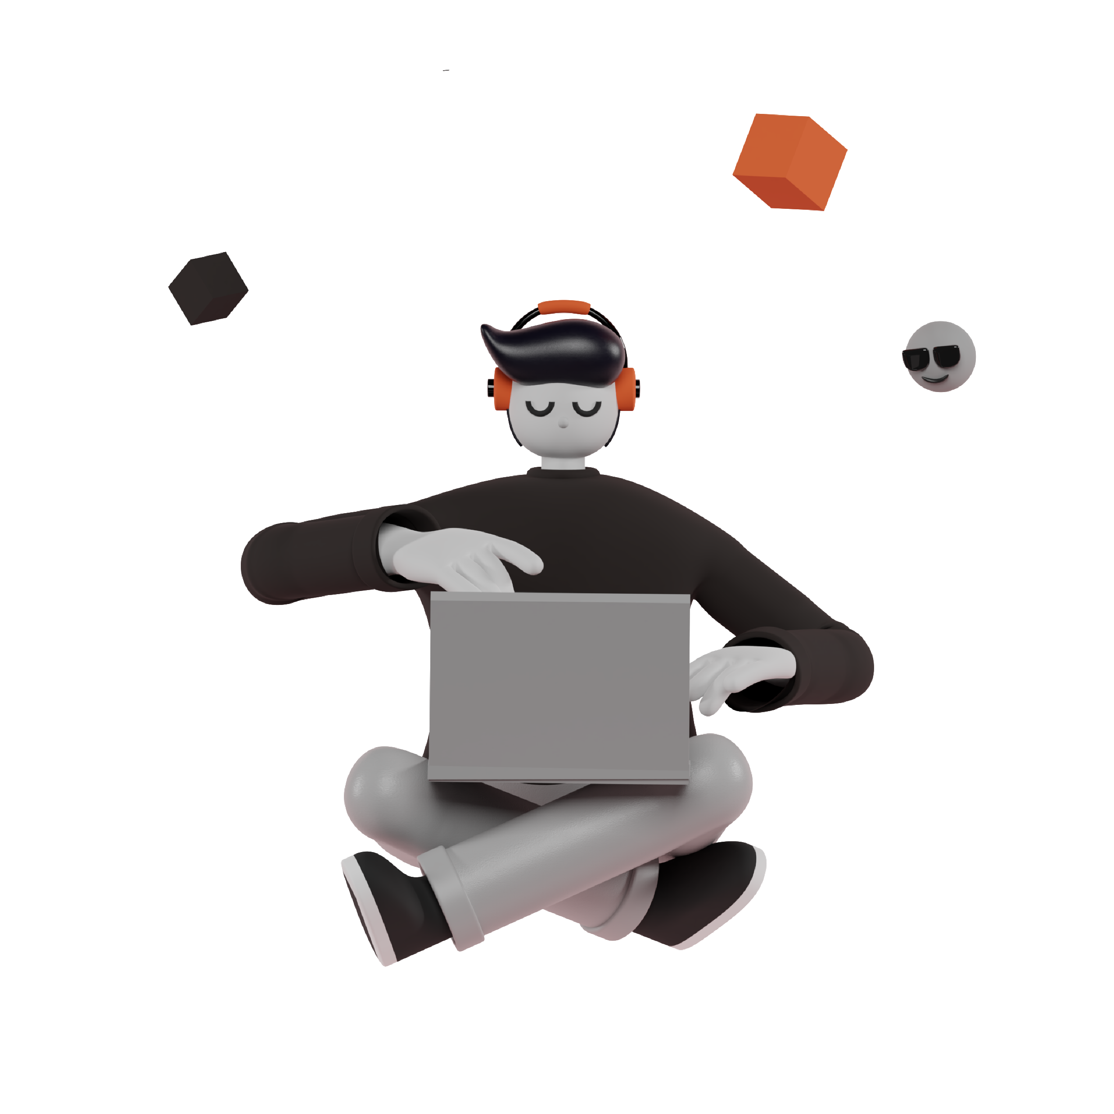
Introduction
Motivation
Implementation
Implementation
How it works?
Generate a human parsing mask with diverse clothes shapes based on the given human pose and user-specified texts describing the clothes shapes.
Enrich the human parsing mask with diverse textures of clothes based on texts describing the clothes textures.
Notes:
The main implementation process is divided into two parts, The first one is to generate a human parsing mask with diverse clothes shapes based on the given human pose and user-specified texts describing the clothes shapes. And then it will enrich the human parsing mask with diverse textures of clothes based on texts describing the clothes textures. We can get more details from this picture. As u can see that, this is the overview of text2human system. It has two stages. As I said it early, the stage one is to translate the human pose to the human parsing according the text describing the clothes shapes. And the stage two to use a sampler with mixture of experts to propose a feed-forward network to efficiently predict the human image.

